Slide 1
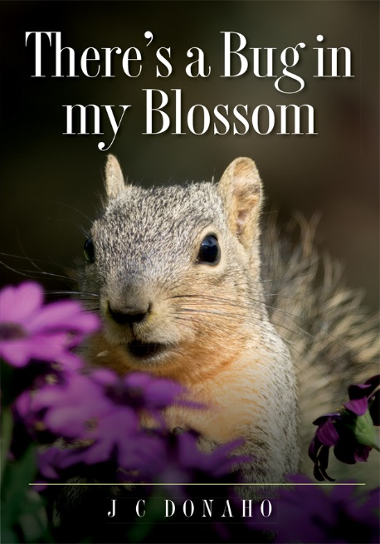
There’s a Bug in my Blossom
J. C. Donaho

Slide 2
Copyright © 2014 J. C. Donaho All rights reserved.
ISBN-10: 1493604066
ISBN-13: 978-1493604067
Library of Congress Control Number: 2014904295
CreateSpace Independent Publishing Platform
North Charleston, South Carolina
This PowerPoint is freely shared with those in the teaching profession.

Slide 3
Dedication
There is beauty to be seen everywhere around us. From the sparkles in a grain of sand to the colors in the scales of a butterfly or the brilliance of a sunset after a rainstorm, the beauty is there. We just need to look. My dad and brother were instrumental in cultivating my love of nature and the outdoors. I thank both of them for sharing that love and appreciation of the environment.

Slide 4
Acknowledgments
Thank you to Jill for supporting me in all my endeavors. Thank you to all my friends and family for your encouragement on this project, particularly to my sister, Susan, for your expert opinions on content. Thank you Cordelia for your review of the technical facts about insects. And thank you to Eralyn and Donna, friends since childhood, who helped give me the idea and pushed for this book.

Slide 5
Looking for bugs
Looking for bugs in blossoms around your house can be a fun adventure! Moving slowly and carefully, examine flowers inside and out. Some of these creatures may be tiny. A magnifying glass is helpful. Do take care with the bees and wasps, which can be aggressive if you get too close. They sometimes are working deep in a flower or sometimes underneath the flower. Give them room, and they will not bother you.
Ready? Let’s go look for some bugs!*

Slide 6
*The word bug as used in this book refers to insects (including the true bugs), spiders, and other creatures that can be found around flowers. True bugs are only a small part of the insect spectrum.

Slide 7
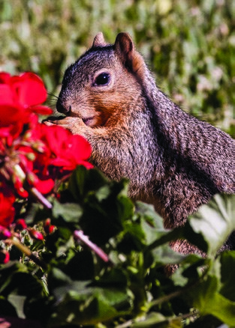
Freddy Squirrel says,
“There’s a bug in my blossom!”
Notes:
Freddy Squirrel is a visitor to Mr. Donaho’s back yard. He is famous for stealing seed from the bird feeders.

Slide 8
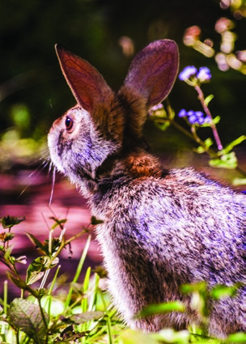
“Yes!” says Missy Rabbit.
“I saw some too! I saw big bugs
and little bugs. I saw spotted bugs
and bugs that don’t look like bugs!”

Slide 9
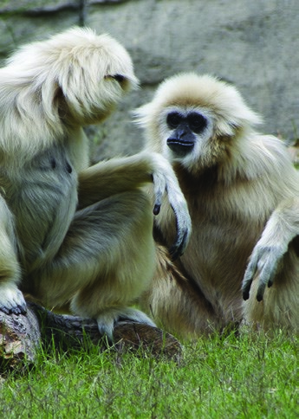
“Did you hear that, Billy Gibbon?
There are bugs in her blossoms!”

Slide 10
Jax the cat says, “Let’s go
look for bugs in blossoms!”
Notes:
Jax Cat lives at Mr. Donaho’s house.

Slide 11
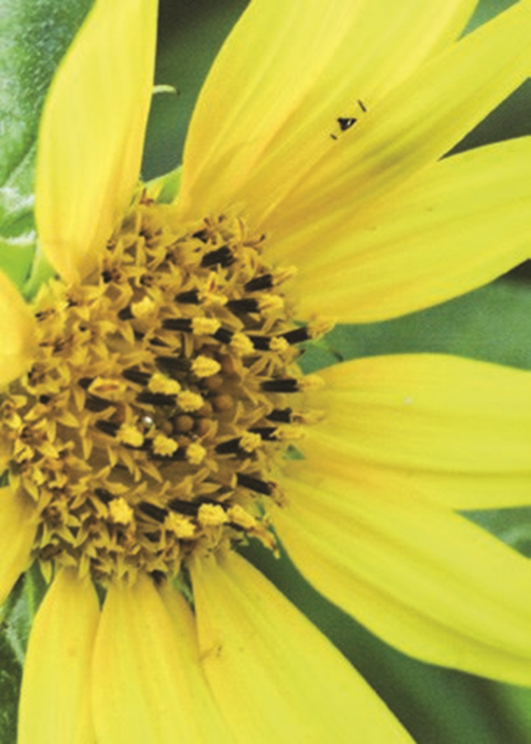
See! A bug is hiding!
Can you see the bug?
Notes:
The bee behind the Coreopsis flower petal has probably found some moisture or nectar to drink. Because bees can often go deep into a flower blossom, you should look before sticking your nose too closely for a sniff.
Bees and wasps are the most common insects you’ll see around flowers. Most are larger and very active. But you may be surprised to see some very tiny bees too.
Bees collect pollen and nectar from flowers. Bees perform an important function in the environment by pollinating flowers and crops.
Often there will be other bugs lurking in and around a flower. Look under the flower or leaves and see what surprises you can find.
A magnifying glass will be very helpful in finding creatures among the blossoms and leaves. Many cell phones and cameras also have a macro setting. You can take macro pictures and load them onto a computer viewing program to see small details. Again, be careful of getting too close to bees and wasps.
The Coreopsis plant is also called tick weed. It is popular as a landscape plant in well-drained, sunny areas. You might see Coreopsis flowers in your neighborhood.

Slide 12
Some bugs are big and hairy!
Notes:
This is a carpenter bee on a buttonbush flower. Bees are insects. Insects typically have six legs. They have a head, a middle section called the thorax, and a tail section called the abdomen. Carpenter bees look a lot like bumblebees. One easy way to tell them apart is to look for the hairs on the abdomen or tail section, of the bee. The carpenter bee’s abdomen is shiny with little hair. The bumblebee’s abdomen is fuzzy with a gold band or bands.
The carpenter bee chews holes into soft wood and creates tunnels to make a nest. They can be destructive if they decide to build their nest in the siding of a building. Bumblebees build nests in the ground.
Not all bees sting, but most do. Bees usually sting only if provoked. As with all wild animals, give them room so they don’t feel threatened. Only the female carpenter bee has a stinger and is able to sting. Although the male carpenter bee is very aggressive protecting the nest by flying at intruders.
Bee populations are threatened by insecticides, viruses, and other insects. They are critically important to our food supply. Without pollination, many plants will not produce the food we need.
The buttonbush grows in moist soils in the eastern and southern United States. Look for the buttonbush around creek banks, lakes, and ponds, where it can grow more than twelve feet tall. It produces a lot of nectar making it attractive to a number of insects and hummingbirds.

Slide 13
Some bugs are smaller.
Notes:
This is another type of bee, the metallic green bee. They are much smaller than honeybees. They are sometimes called a sweat bee because they look like another type of bee that is attracted to human sweat. This bee can also be blue but is still called a metallic green bee.
They are a short-tongued bee, so they will most often be seen on flowers that have an open structure. Sunflowers, buttonbush, and lantana are examples of flowers where you can find the metallic green bee. You will not usually find them in flowers with deep trumpets where the nectar is hidden deep inside the blossom.
These bees build nests underground like the bumblebee. A preferred nest location would be a bare spot on the ground with lots of sun
The metallic green bee is found in North and South America but not in Europe or Asia. There are about forty species of this type of bee. There are over twenty thousand different types of bees on earth!
A fun way to enjoy watching insects is to grow flowers that attract them. Wildflowers attract many different insect species and provide bright color in the spring. Or you can visit other places with flowers. Many of the pictures in this book were taken in my yard, at the park, or at a garden center.
As you can see, the buttonbush is popular with different bees as well as other insects.

Slide 14
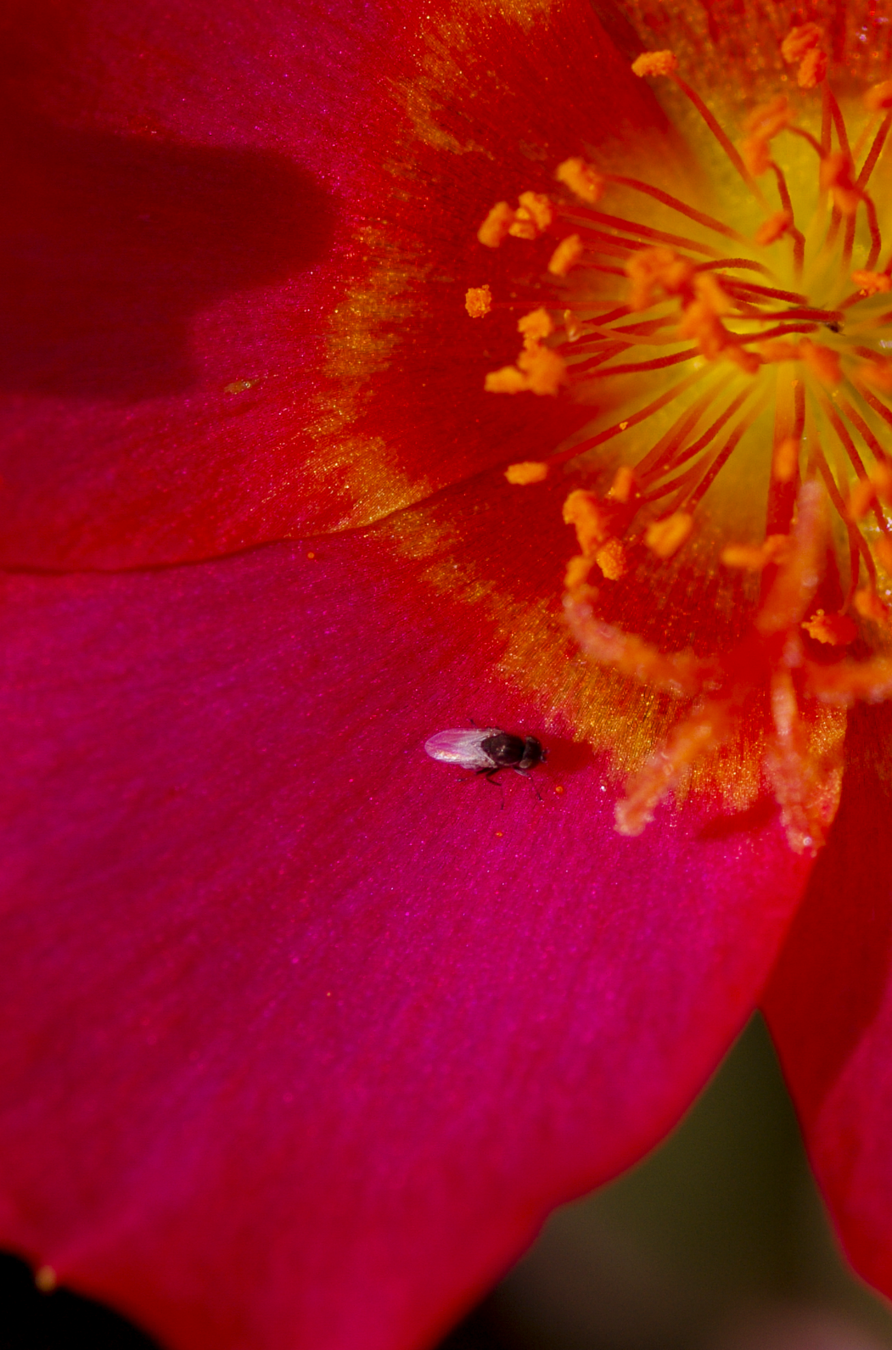
Some bugs are tiny!
Notes:
Bees and wasps are only part of the pollination story. Flowers attract many other insects that assist with pollination. Pollen is sticky. It sticks to the body or hairs of the visiting insects and is then carried to other plants where it is rubbed off or sticks enabling pollination. Pollination only works among the same plant species. Pollen from an apple tree only pollinates other apple trees. Apple tree pollen from an apple tree won’t pollinate an orange flower on an orange tree for example.
This tiny fly has made a stop on this blossom. Flies are attracted to the sweet nectar in flowers or to moisture. As it moves around the garden landing on different flowers, tiny pollen grains stick to the fly’s legs or body hairs. Those pollen grains are then carried and transferred from plant to plant.
This cross-pollination from plant to plant is critical for the survival of many plant species. Without it the female plants cannot be fertilized to produce seed. Seed is necessary for the plants to reproduce for the next crop. Pollination occurs in many ways. The wind spreads pollen for a number of plant species. But there are many important food crops that need insects such as bees and wasps for pollination. These are foods that we depend on for our well-being. Examples of those foods would be fruits, vegetables, and grains.
The poppy plant is found growing in many parts of the world and is attractive to bees and butterflies.
This fly is smaller than a grain of rice.

Slide 15
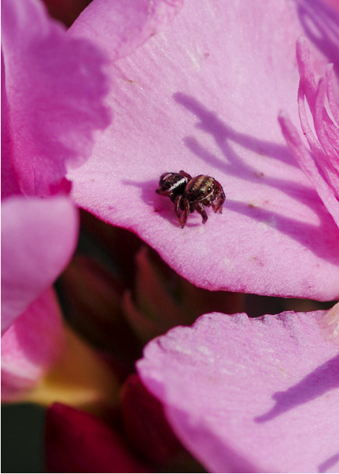
Some bugs are looking for a meal. Can you see him?
Notes:
Many animals use flowers to hunt other animals. This little juming spider is waiting for an unsuspecting meal to fly or crawl by.
Spiders are not insects. They belong to the class of animals that also includes scorpions, fleas, and ticks. They are called arachnids. There are over one hundred thousand species of arachnids. Arachnids have eight legs, so an easy way to tell a spider from an insect is to count legs. There are six legs for insects and eight for spiders, scorpions, mites, and ticks.
Instead of building a web, this little jumping spider will hide and wait until a small bug comes near, then jump to catch the bug. Those large eyes help the spider to accurately target the prey.
This spider is a little bigger than the size of George Washington’s nose on the head side of a quarter dollar.
As is often the case, small animals become food for larger animals. They are part of the food chain. This small spider must also lookout for animals that might find it tasty. In turn, animals that might eat a wolf spider become food for something else usually larger. Let’s say the wolf spider stalks and catches a small fly. A damsel fly then swoops in and grabs the wolf spider. The damsel fly out looking for more food is snapped up by a lizard. The lizard then becomes lunch for a garter snake. A roadrunner bird finds the garter snake later and decides it will make a nice afternoon snack. But the roadrunner is not safe either. There are always other predators higher in the food chain.
So when you are looking for bugs, especially outdoors, you have to also look for those other animals higher in the food chain. Make sure you to look carefully before putting your hands into the plants.

Slide 16
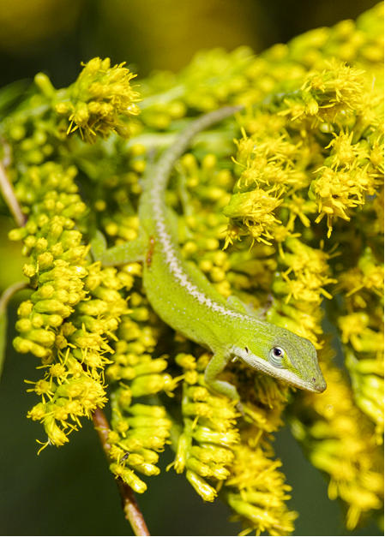
That is not a bug!
What is he doing here?
Notes:
Because flowers attract insects, animals that eat insects are also attracted to flowers. This Carolina Anole or common green anole, often called a chameleon, can find many types of insects for his next meal waiting here under the leaves.
While not a true chameleon lizard, the green anole can change color to blend with the background. I have seen them go from green to brown to gray. Blending into the background is helpful when hunting for food. It is also helpful to prevent the anole from becoming food. Many birds and other reptiles eat lizards. They also flash colors to communicate with other lizards. The male anole also has a large flap of skin under the neck called a dewlap that turns bright pink and is flared in territorial or in breeding displays.
Specialized cells called chromatophores in the skin layers are responsible for color changes. Signals from the lizard’s nervous system trigger the cells to reveal the colors. This works much like a computer that signals LEDs to show different colors on an outdoor display sign.
The anole is resting on a goldenrod plant. In some parts of the world the goldenrod is considered a weed. In other parts of the world it is grown as a garden flower. Goldenrod produces lots of pollen that can cause allergies in people. It depends on insects for pollination because the pollen is heavy and sticky, too heavy and sticky for wind pollination.

Slide 17
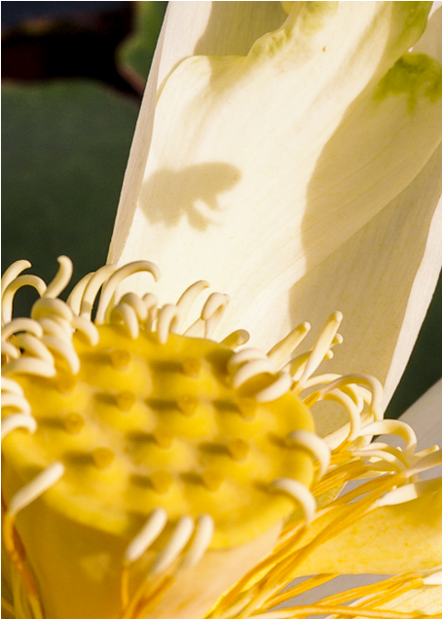
Can you see the shadow of a bug?
What kind of bug is it?
Notes:
This bee’s shadow is cast on a lotus blossom. Lotus plants are water plants with large leaves and yellow, white, or pinkish flowers. The American lotus typically has yellow flowers. They are sometimes confused with the common water lily. The American lotus can have leaves or pads that are three feet across. They are strong enough to support many small water birds.
The American lotus, while beautiful and providing habitat for many species, can be a nuisance plant that can rapidly cover the surface of lakes and ponds. Some species of birds require open water to find food. Once the surface of a lake or pond is covered with lotus plants, those birds have to find other areas for food. The leaves also shade other water plants below the surface and prevent them from growing. Those other types of water plants may be food or habitat for other forms of life including fish. Pretty soon there is nothing in the lake except lotus. The lack of diversity of plant and animal life is not healthy and will eventually cause that lake ecosystem to crash.
Sometimes it is fun to see something like a bee’s shadow. You have to be quick to see it though. What is needed to see a shadow? You need a light source, a subject, and a background. In this picture the sun is the light source, the bee is the subject, and the lotus is the background. A shadow can only occur when the subject is between the light source and the background. So, to see a bee shadow on a lotus flower is not easy. In this case the camera saved it for you and me.

Slide 18
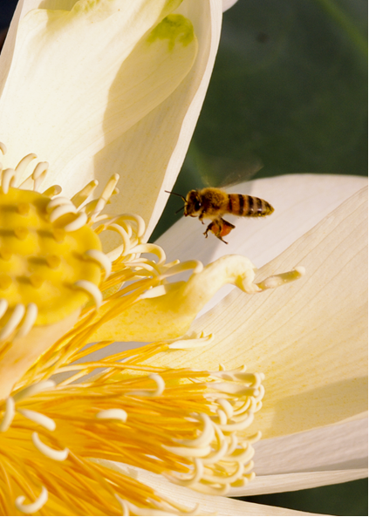
Is a bee a bug?
Notes:
This is a trick question. The bee is an insect but technically is not a bug. The true bugs make up a small part of the class of invertebrates known as insects. Count the legs. Sometimes antennae and mouth parts can look like legs. There are six legs, so the bee is an insect.
Look at the full pollen sacks on the rear legs. Why do they collect pollen? Pollen is used to feed young bees. But first it must be made into “bee bread.” The bee mixes pollen in its mouth with nectar and water. The pollen granules swell into bee bread. The bee bread is then stored in the honeycombs until it’s needed by the young bees.
Bees also collect nectar, which is the main direct food for adult bees and for making honey, which is used as a backup food source.
Honeybees are critical to our food supplies, but they are dwindling in numbers. When we think of food and bees, we usually think of the bee honey that we put on our biscuits. But it is more than that. Bees specifically are necessary to pollinate many of our food plants. Without bees there might not be enough food for us to eat.
Why are bees disappearing? We are not sure about all the reasons. We know for sure that widespread insecticide use is a problem for bees and other pollinating insects. But there are also bee viruses that can wipe out entire colonies in a very short time. Researchers are working now to understand how to save them.
We can help by reducing the use of insecticides in our own gardens. When insecticides must be used, great care is required. Many times insecticides can be replaced with more natural controls.

Slide 19
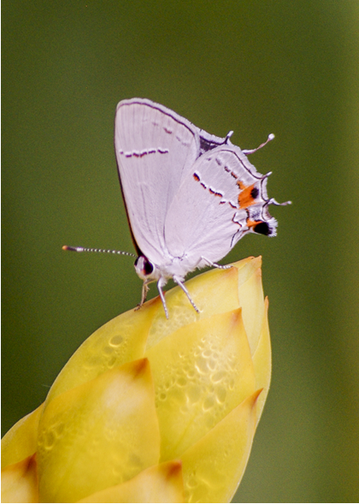
Look at the butterfly!
What do you think this butterfly is doing?
Notes:
The flower is closed, but there is moisture trapped inside. This picture was taken on a very hot, dry day. The butterfly is sipping water that has condensed inside the flower.
This is a gray hairstreak butterfly. There are many different types of hairstreaks and different colors. All hairstreaks are smaller butterflies with fringed hind wings and white streaks on the undersides of the wings. They live from Canada all the way south to Venezuela. Butterflies are found on every continent except for Antarctica. There are about seven hundred species of butterflies in the United States.
The butterfly life cycle is divided into four stages. Eggs are laid on a host plant, the eggs hatch into caterpillars, the caterpillars pupate in a chrysalis or cocoon, and then they emerge as a full butterfly. The host plant is important because that is the preferred food the caterpillar will eat. If you know what the caterpillar of a particular butterfly eats, you can probably find a chrysalis.
Why do we have butterflies? It is certainly nice that we have such beautiful creatures to see. But they have a role. They specialize in eating or drinking nectar. In doing so, pollen sticks to their bodies. As they go from flower to flower, pollen rubs or falls off to pollinate new flowers. Those pollinated flowers then form seeds that become part of a fruit, vegetable, or a grain.
Butterflies are also considered a good indicator of the relative health of the environment. If butterflies are having problems, then there is a good chance the environment is in trouble.
The plant waiting to bloom is a candle bush or candelabra tree.

Slide 20
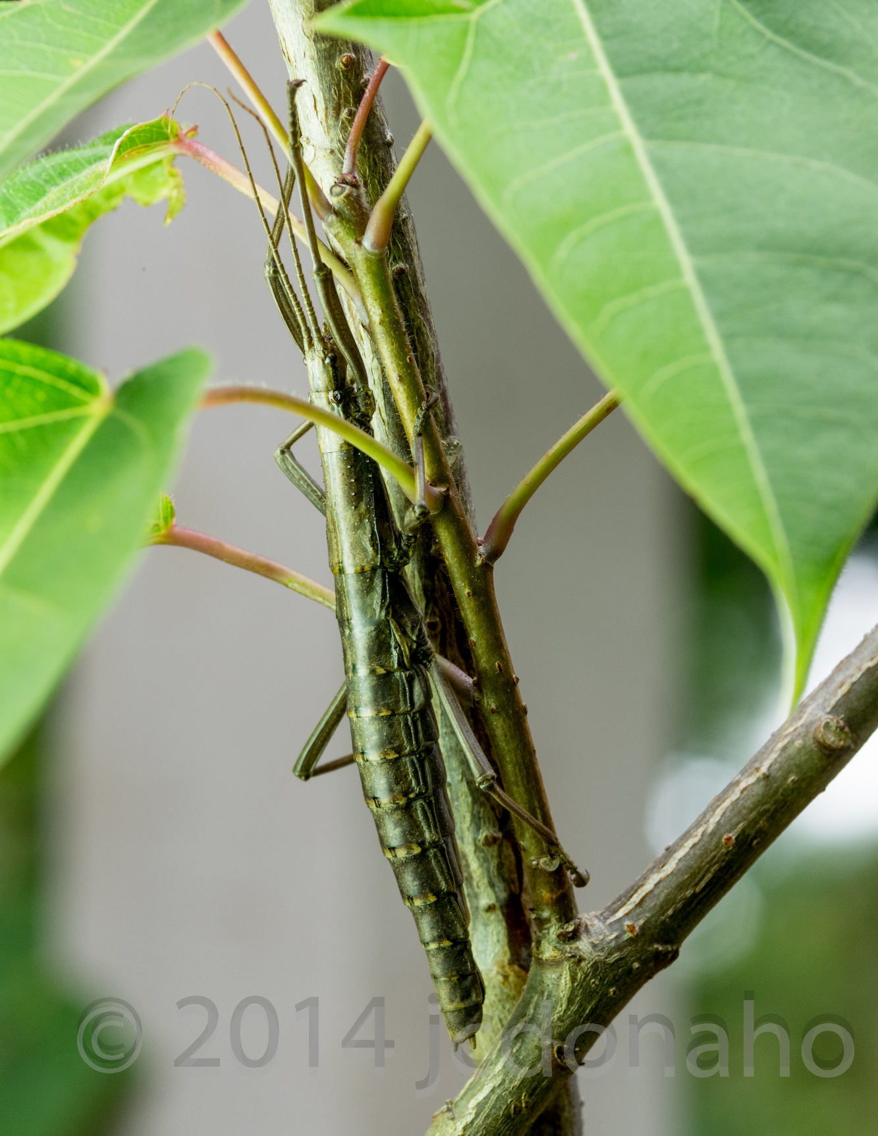
Some bugs look like sticks.
Can you see the walking stick?
Notes:
Walking sticks are long, flightless insects that can look like sticks. They eat plants. Typical host plants include oak, hickory, hackberry, apple, birch, pecan, and cherry. They are sometimes confused with the praying mantis, which is a predatory insect.
They use their shape, color, and slow movement to hide from other animals. You are a good observer when you can find a walking stick in the wild. The best places to look are on the typical host plants in the list above. You don’t need a magnifying glass to spot a walking stick either.
Interesting behaviors make the walking stick a fun insect to find. Some will rock back and forth on a plant to mimic a twig blowing in the wind. Some will play dead. They drop off the plant and fall to the ground motionless when threatened.
Walking sticks, or stick bugs, are found in warm climates all over the world. Some walking sticks are nearly two feet long when their legs are stretched out!
They are sometimes kept as pets, but it is important to know the species and the favored food plant. Many stick insects will eat only certain plants. They will not survive if fed the wrong plant. Walking sticks can’t bite, but some species use chemical warfare against predators. They can spray an irritating substance like tear gas to repel would be enemies.

Slide 21
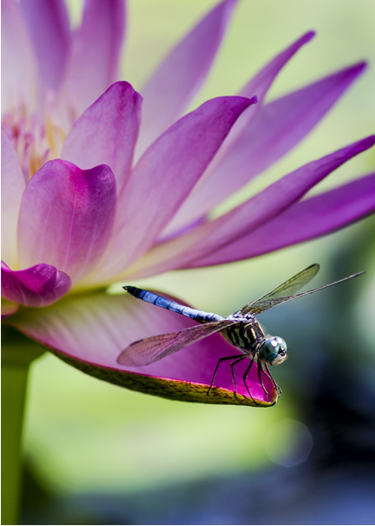
Some bugs fly fast!
Notes:
Dragonflies are found worldwide, usually living around streams, lakes, and wetlands. They eat other insects. They are important because mosquitoes are a big part of their diet. They will also eat a wide variety of flying insects including bees and wasps.
There are nearly six thousand different types (species) of dragonflies. Different species are usually identified by their different colors. Colors range from blue and green to hot pink and gold. Some dragonfly species are believed to have been on earth for over three hundred million years. That was the time of the dinosaurs and makes this type of dragonfly one of the earliest flying insects.
Those large eyes allow the dragonfly to see in many directions at once. This is very important to a flying predator like the dragonfly. It also makes it harder to catch a dragon fly. Other animals do include dragonflies in their food menu. Birds, frogs, fish, and lizards all feed on dragonflies.
One species of dragonfly was reported to have flown at sixty miles per hour, making dragonflies the fastest insect. Most fly about ten miles an hour.
A look-alike insect is the damselfly. Damselflies fold their wings back at rest. Dragonfly wings are always held out flat when at rest.
Dragonflies are most often found around water because the insect species they normally eat also live around water. Aquatic plants such as this water lily provide resting sites as well as locations to watch for food. It is interesting that water lilies are one of the first flowering plants. It is very possible that prehistoric dragonflies perched on water lilies and watched dinosaurs.

Slide 22
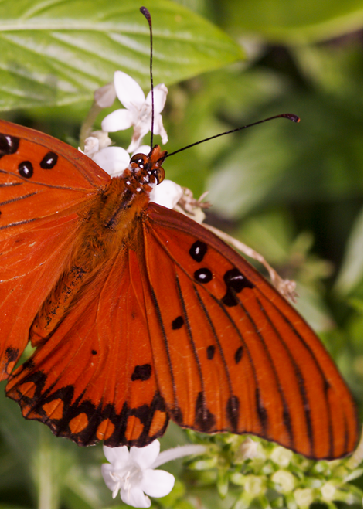
Some bugs are
too pretty to hide.
Notes:
The most colorful and popular visitors to a garden are the butterflies. There may be as many as twenty thousand species of butterflies on earth. Butterflies are mainly daytime fliers. This is a Gulf Fritillary or passion butterfly. They are a common sight from Argentina north to the southern United States, and as far as San Francisco on the west coast of the United States. They get their name because of the migratory path over the Gulf of Mexico.
Butterfly wings are covered in tiny scales, which give color either through pigments or by scattering light to reflect different colors. If you handle a butterfly, the scales look like powder on your fingers. This is why it is not a good idea to handle butterflies by the wings.
Adult butterflies taste with their feet and have a sense of taste two hundred times stronger than humans. They eat only liquids. The proboscis is used like a straw to collect water and nectar from plants.
Butterflies lay eggs, which hatch into caterpillars. Caterpillars eat and grow, and then they transform into a pupa or chrysalis. The butterfly emerges from the pupa after a process called metamorphosis. Once the butterfly emerges, the life span is relatively short. Most species live for only one or two weeks. Some, such as the monarch, can live as long as a year.
Butterflies provide a service to flowering plants by transferring pollen from plant to plant. Encourage butterflies in your garden or planter by planting flowers and bushes that are known to attract butterflies. The aptly named butterfly bush is a very good plant for attracting butterflies. Lantana, verbena, sage, dianthus, and lavender are just a few of many plants that butterflies use for feeding.

Slide 23
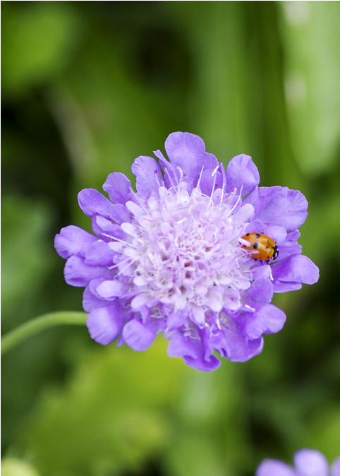
Can you see
the spotted bug?
Notes:
The familiar ladybug, ladybird, or lady beetle is a favorite to see in the garden. They are a small beetle found all over the world in areas with a climate to support crops. There are about five hundred different kinds of ladybugs. Black spots on a red or yellow back make them easy to identify. Ladybugs may be a lot of other colors too, pink, white, orange, and even black. Some ladybugs may have stripes or even a solid-colored back. What you are seeing on the back of the ladybug are the wing covers. That bright coloration on the wing covers serves as a warning to some predators, like birds. That coloring tells birds that the ladybug does not taste very good. Many insects with red colors are signaling danger to other animals. That red coloration is protection for the ladybug and other animals. Predators know to avoid them because they are poisonous or taste bad. We use red lights and signs to signal danger, too.
Ladybugs can be helpful in the garden by feeding on aphids and other small insect pests. If the population gets out of balance, however, there can be too many ladybugs. Then the ladybug becomes the pest because it eats good bugs or bites people.
Did you know that ladybugs can produce a toxic chemical? That chemical is why ladybugs taste bad to birds and other predators. If a ladybug is disturbed, it may leave behind a yellow mark. That is a foul-smelling bloody discharge to discourage predators. Many insects are capable of synthesizing toxins from plants for self-protection.
When you think about it, there is an amazing amount of life going on in your yard or planter box. You have life and death, chemical warfare, and the food chain all happening right at your back door.

Slide 24
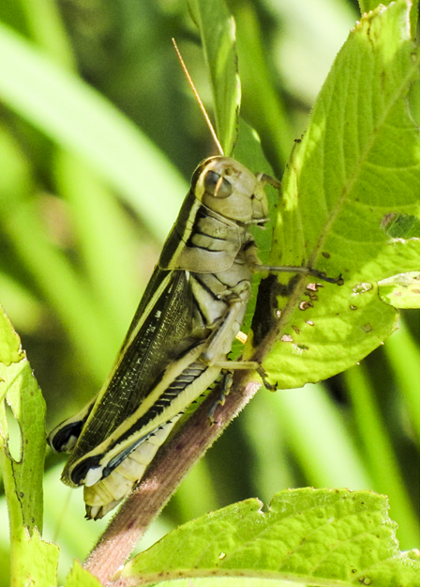
Some bugs eat
holes in plants.
Notes:
There are nearly ten thousand different types (species) of grasshoppers on earth. They are easy to identify with their large legs for jumping and big eyes. They also have large biting jaws called mandibles for cutting and tearing grasses and other plant life. Grasshoppers can bite your finger if caught. They have been around since before the time of the dinosaurs.
Did you know that grasshoppers are good at flying? They not only have strong back legs for jumping, but they also have large wings to help them cover larger distances. Their wings are also used to help them “sing.” Grasshoppers rub the rough parts of their hind legs over the edge of the wing to produce sound. Listen for the grasshopper’s song in the summer.
Grasshoppers eat plants. One grasshopper eats half its body weight in plants each day. A lot of grasshoppers can eat a lot of plants in a day. When grasshoppers swarm in large groups, they become known as locusts. A swarm of locusts can wipe out crops, causing people to have less food and go hungry. In 1954, a swarm of locusts wiped out all the vegetation in a 200 square kilometer area in Kenya. That sort of devastation can lead to famine for humans and other animals. Grasshoppers are considered a pest for that reason.
The grasshopper is a prime food source for many other animals. Birds, mammals, and reptiles find the grasshopper to be quite tasty. In some parts of the world, grasshoppers are an important food source for people, too. Grasshoppers are eaten boiled, fried, grilled, dipped in chocolate, sautéed, or even raw! Do you want a bite?

Slide 25
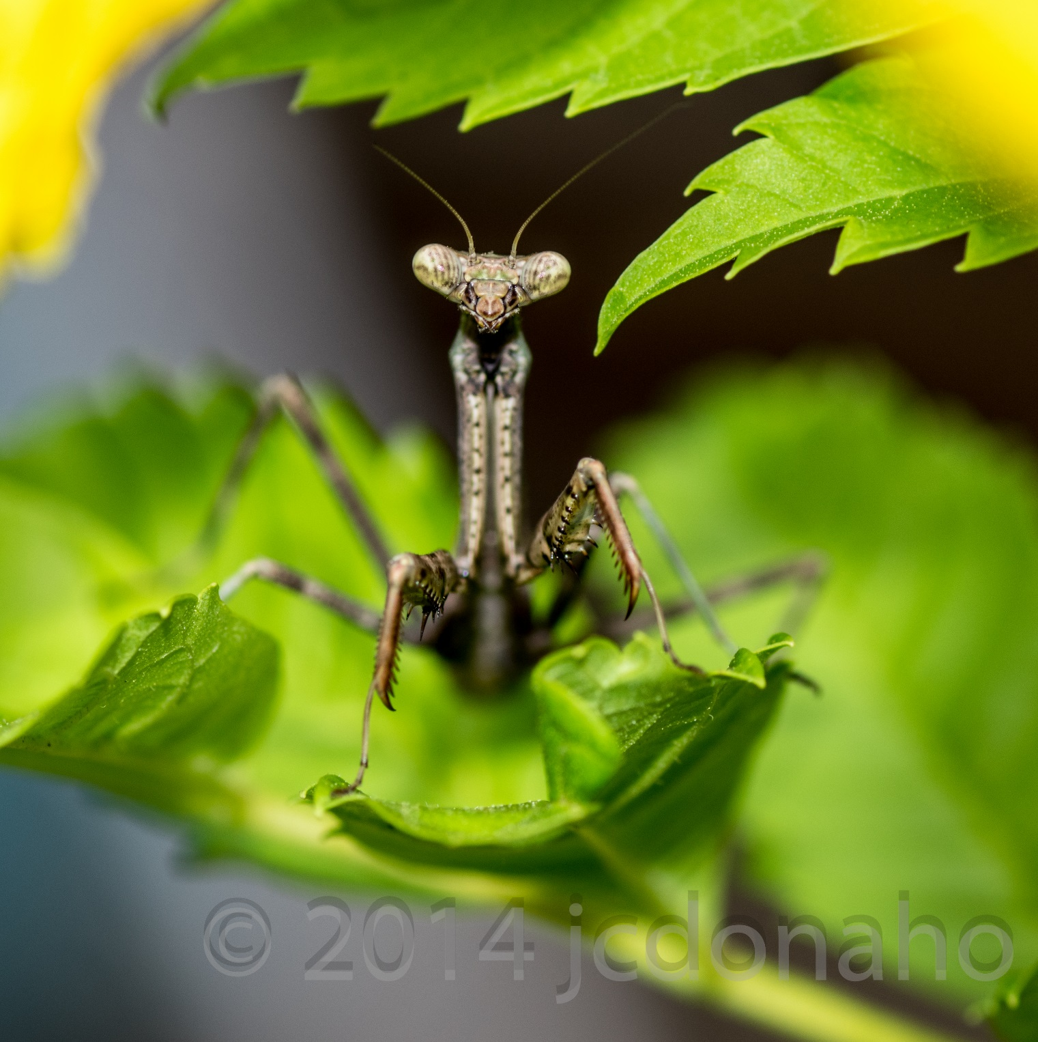
What a funny bug!
Guess where his ear is?
Notes:
Of all the creatures you might find in the garden, the praying mantis might be the most interesting. Did you know that the mantis, the cockroach, and the termite are thought to be related? They sure don’t look like a termite. The mantis is found mostly in warm climates, although there are eighteen known species found in the United States. The praying mantis can grow to be quite large. In some parts of the world, they are over six inches long!
Did you know that the praying mantis is the only insect that can turn its head and look behind? That is one of the things that makes them so interesting to watch.
The other interesting thing to watch is how the praying mantis hunts other insects and small creatures. They are fierce predators, able to snap the front legs in an instant to capture an insect, a small lizard, or even a bird. It usually waits quietly until its food is within range. Those front legs shoot out faster than the blink of an eye with great accuracy. If you don’t move around much, you can sometimes watch a praying mantis catch a meal. You don’t have to worry about being very quiet around a mantis. They may only have one ear, which is located on their belly!
A praying mantis in the garden can be both good and bad. Praying mantises eat whatever comes their way. That means they eat the beneficial animals in the garden, too. For that reason, a lot of praying mantises in the garden is not helpful and may be damaging to that ecosystem.
An ecosystem is the community of all of the living things and how they interact in a given space. That ecosystem can be a flower pot, your garden, or something as big as Texas.

Slide 26
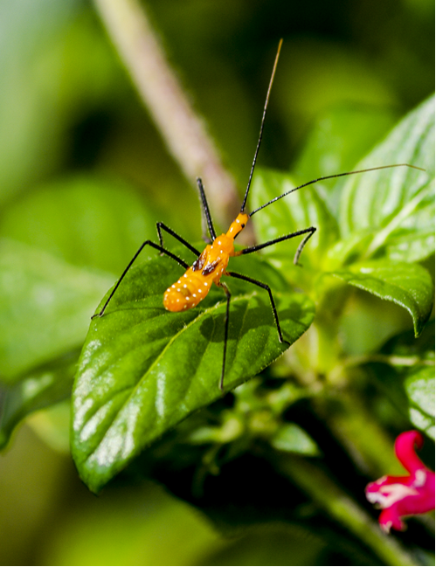
I see six legs.
Are those tiny wings?
Notes:
This brightly colored bug is called a Milkweed Assassin bug. The assassin bug is a true “bug” in scientific terminology. True bugs include aphids, cicadas, hoppers, and water bugs. True bugs all have piercing and sucking mouthparts. They do not bite or chew.
The assassin bug is another predatory bug, feeding on other bugs and insects in the garden. Assassin bugs move slowly over and under the leaves of plants, searching for or waiting to ambush a bug to eat. Any time you see an insect moving very slowly around a plant, you should suspect that it might be a predator. They are an underappreciated beneficial insect in the garden.
There are nearly four thousand species of assassin bugs, with many different colors and body shapes. The one in the picture has tiny red nonfunctioning wings. They are vestigial wings, meaning that at one time this species of assassin bug had regular wings. Over time those wings were not needed, so today only the hint of wings remains.
Usually brightly colored insects like this one use that color as a warning to would-be predators that they do not taste good.
Some assassin bugs like the bed bug hunter are pests to humans. They are also known as the kissing bug. They pierce the skin of humans around the mouth and feed on blood. This “bite” can be very painful. Some assassin bugs carry tropical diseases that are spread when they feed on humans. Because all assassin bugs have a sharp beak, handling them is not recommended.
Just remember that assassin bugs found in the garden are important and good for keeping other insect pests under control.

Slide 27
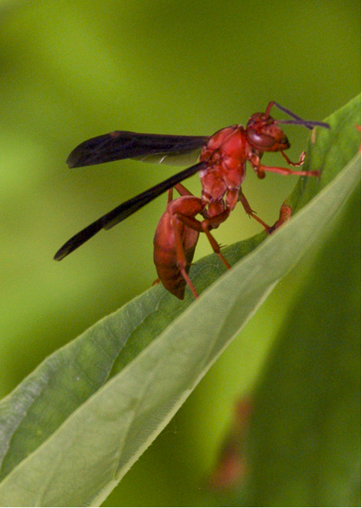
Better stay away from this guy.
He can sting.
Notes:
Wasps like this red wasp are very common over most land areas of the earth. There are over twenty thousand different kinds (species) of wasps! Most look very wasp-like, but some do not. They might look like a bee or even an ant. Most wasps are easily identified by the tiny waist separating the thorax from the abdomen.
Wasps can be parasitic, laying their eggs in or on other insects. They can be solitary predator wasps, or they can be the hunting wasps that form social groups. Yellow jackets and red wasps are part of the social wasp group. They cause the most problems for us because we are likely to come into contact with their nests around our houses and gardens. They will aggressively protect their nests by stinging.
Not all wasps sting, but unless you know the difference, it is best to give them space. This red wasp can definitely sting. Some people are allergic to insect stings. Difficulty breathing after an insect sting is a warning sign, and medical attention should be sought right away.
Wasps are omnivorous, eating both plant material and other insects. Because they have few or no body hairs, they are not effective pollinators. Even though not effective, they are still part of the pollination scheme because they are moving around flowers eating nectar or hunting other insects. Even a little pollen is enough for pollination.
So what do wasps do in nature? Their main role is as a predator to other insects. Without wasps, other insect pests might get out of control. Wasps do not have to pollinate plants to be useful.

Slide 28
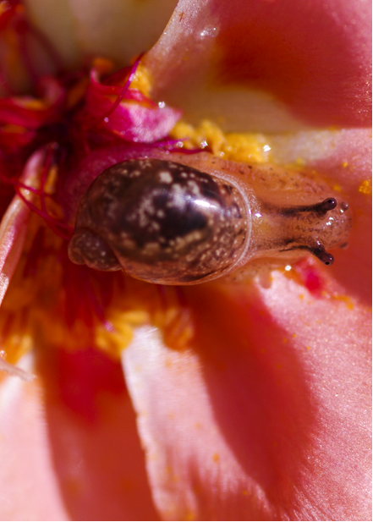
What is this?
It is not a bug!
Notes:
This was a fun surprise! I went out early one morning to the garden center to take pictures. It had rained overnight, so everything was wet. As I looked at the flowers, I saw this wonderful surprise. It was a tiny snail in a small moss rose flower.
This is a newly hatched land snail. It is perhaps one week old. The shell is still soft at this point. It takes about ninety days for the shell to fully develop and another year for the snail to be fully grown.
Snails are mollusks. They live in many different habitats, on land and in fresh and salt water. Some people like to eat snails. The giant African snail can grow to half a foot long!
The group of animals known as mollusks is huge and diverse. It includes not only the snails, but octopus, squid, oysters, and mussels. Mollusks are invertebrates, meaning they do not have a backbone.
Archeologists searching through prehistoric digs have found that snails were part of the menu even in the earliest of times. Properly prepared, snail dishes called escargot, are a popular restaurant menu item. They are supposed to be especially good cooked with butter and garlic.
In some parts of the world, snails can carry disease. It is a good idea to wash your hands after handling a snail.
I had never seen a baby snail before. It is amazing what you can find when you start looking.

Slide 29
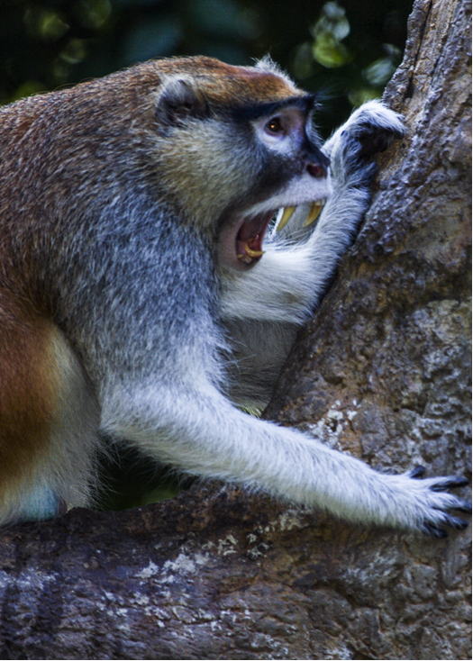
“Wow! Did you see
all those bugs?”

Slide 30
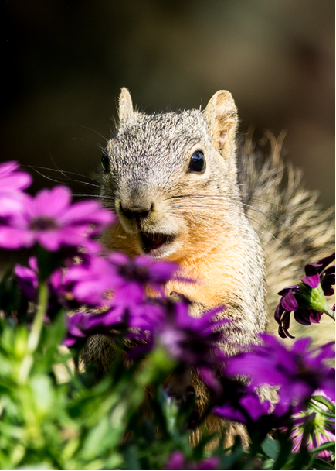
“Yes, and all we had
to do was look!”

Slide 31
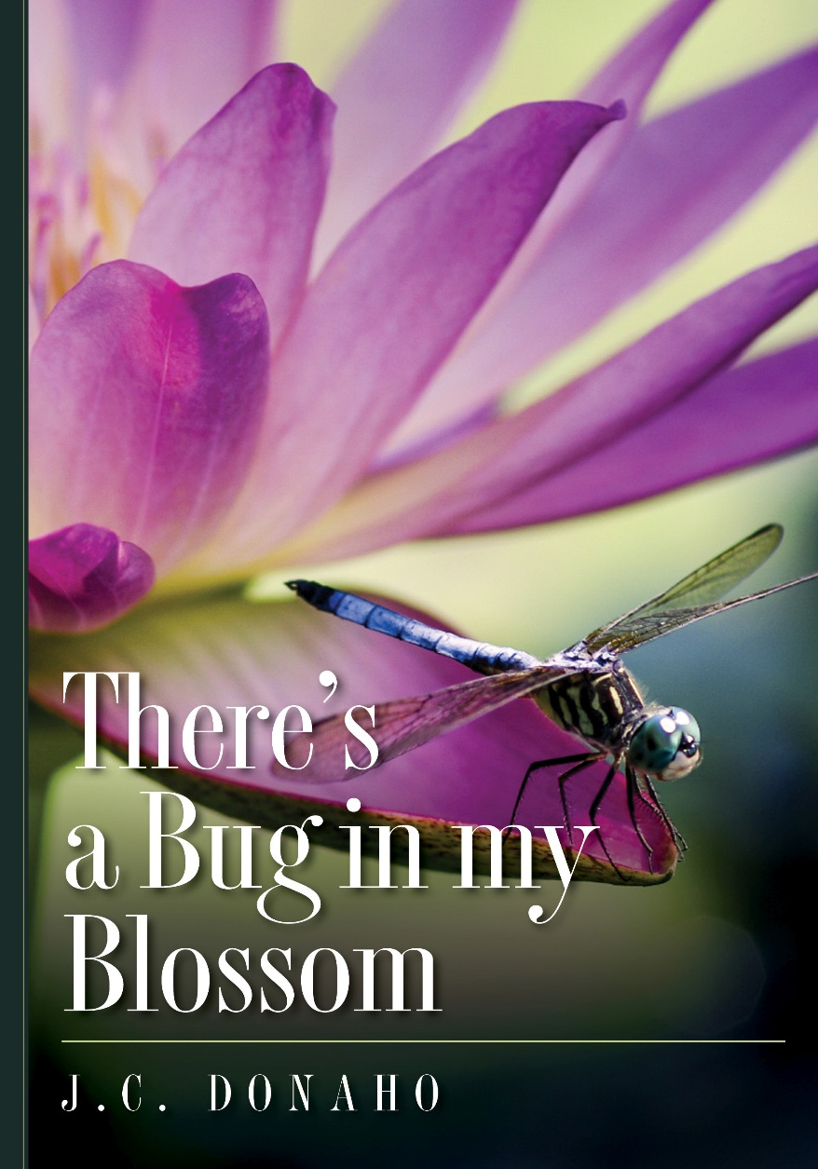
The End

Slide 32
For more information check out:
www.bugsinmyblossom.info

Slide 33
ABOUT THE AUTHOR
J. C. Donaho is a management consultant to the biomedical research community. He has been involved with animals all of his life, from pets to careers in zoos and in animal research. As a child growing up in Central Texas, he had fun playing with tarantulas and horned lizards in his backyard. He earned his bachelor’s degree from Texas A&M University in zoo administration and immediately entered the zoo world, first as a zookeeper and then later as a zoo curator. He has dedicated the last twenty years to the health and welfare of animals in necessary biomedical research. In his career he has been able to work with a wide variety of animals, including vampire bats, Tasmanian devils, sea lions, big cats, monkeys of all sizes, birds, and reptiles. It was during the zoo years that he further developed his photography interests. An avid photographer, he can often be found photographing landscapes, wildlife, and sunrises and sunsets. He and his wife have been involved in various animal rescue projects for more than thirty years.
John shares his life with his wife of more than forty years, four children, and an assortment of dogs, cats, and birds that find their way to his home.

